Slide 1
How to Make a Rose out of Duct Tape
Michael Nolan

Slide 2
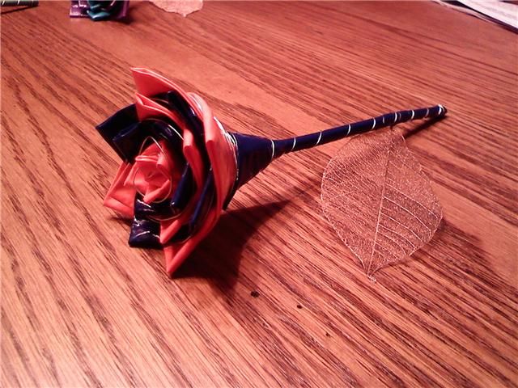
Duct tape has long been celebrated as the material that can fix anything and do anything. While this may be an exaggeration, it can be used to create a unique and beautiful flower. This will show you how you can make a rose out of duct tape in just a few minutes.

Slide 3
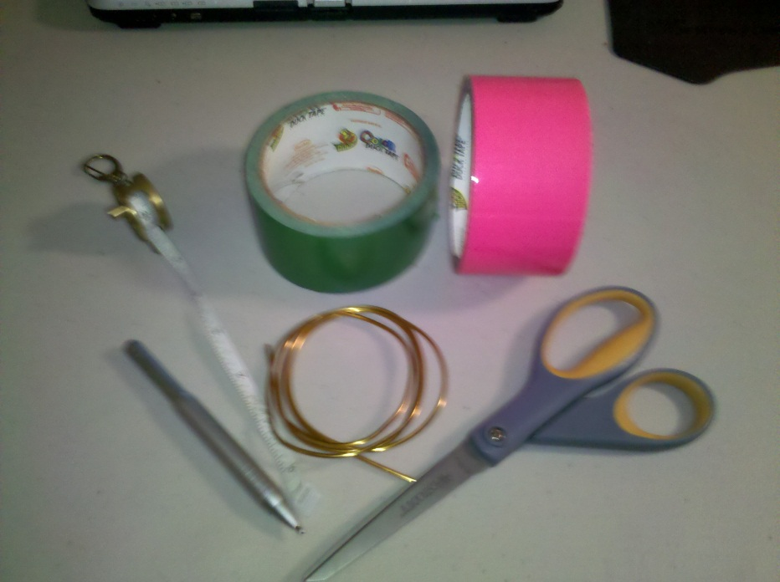
Materials
1 roll of green duct tape
1-2 rolls of colored duct tape (other than green)
1 roll of floral wire
1 pair of scissors
1 ruler or tape measure
1 pen (able to mark on duct tape)

Slide 4
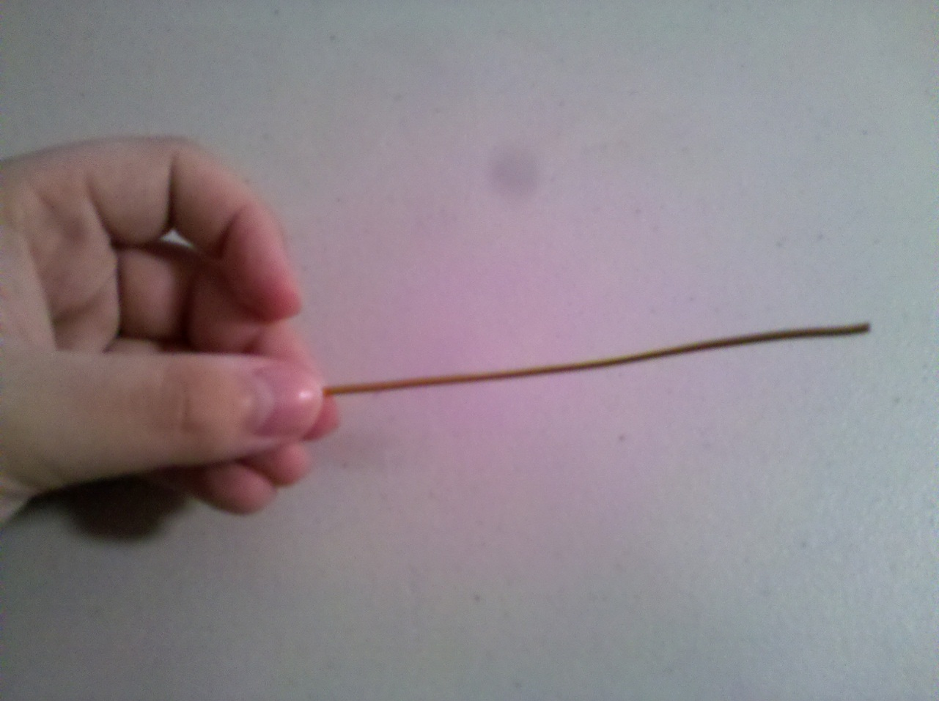
1. Cut a length of floral wire about five (5) inches long.
Steps

Slide 5
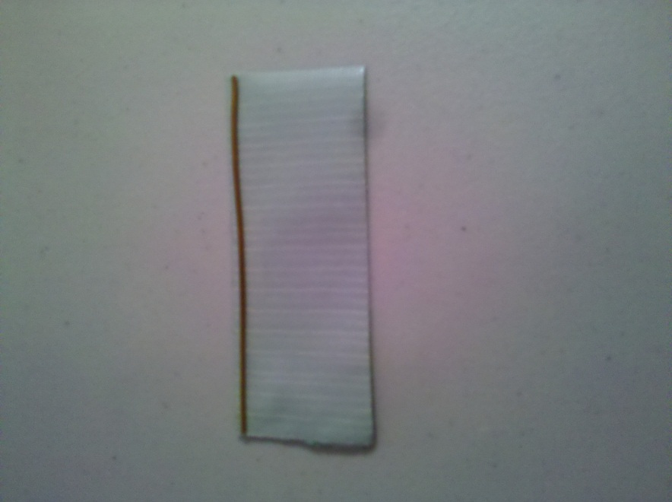
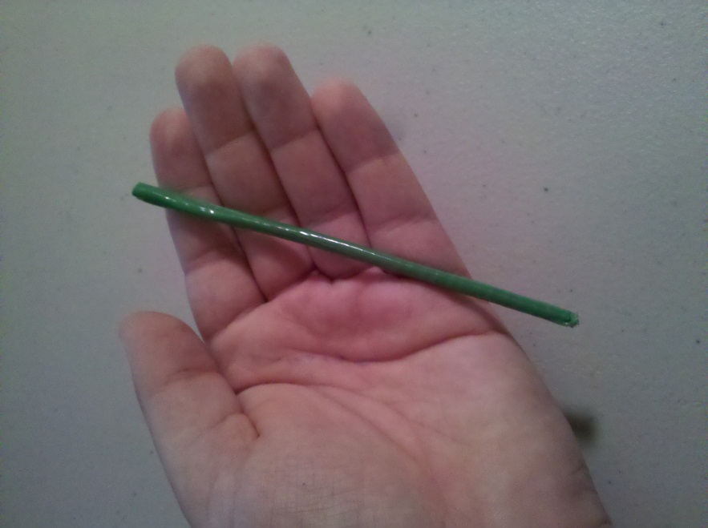
2. Cut a strip of green duct tape the same length as the floral wire. Place the floral wire on the edge of the strip, and roll the strip around the floral wire until you have a green cylinder. This will form the stem.

Slide 6
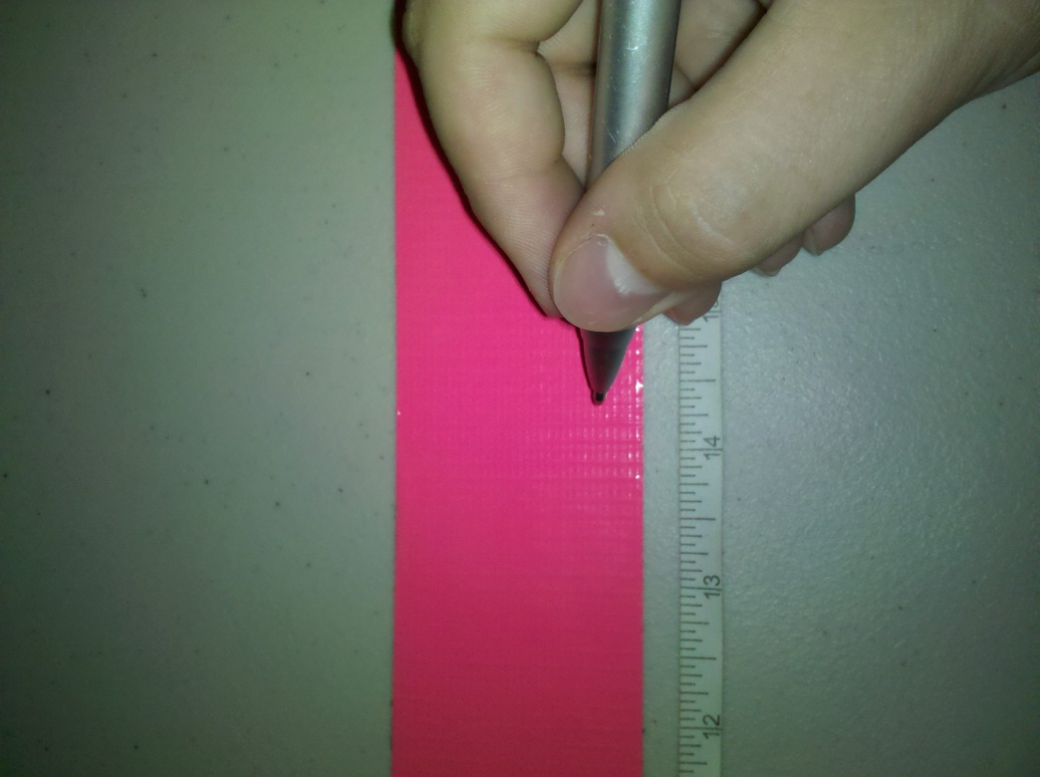
3. Unroll a strip of colored duct tape several feet long. Use your ruler and pen to mark two (2) inch increments along the strip. Tip: to make this easier, lightly stick the strip to a surface from which you can later easily unstick the strip.

Slide 7
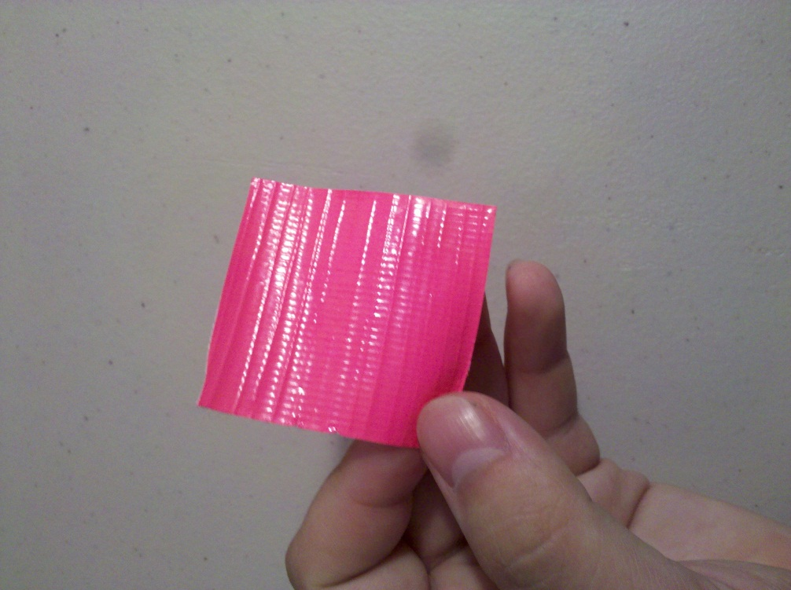
4. Cut the strip at each two (2) inch mark to end up with square pieces of duct tape.

Slide 8
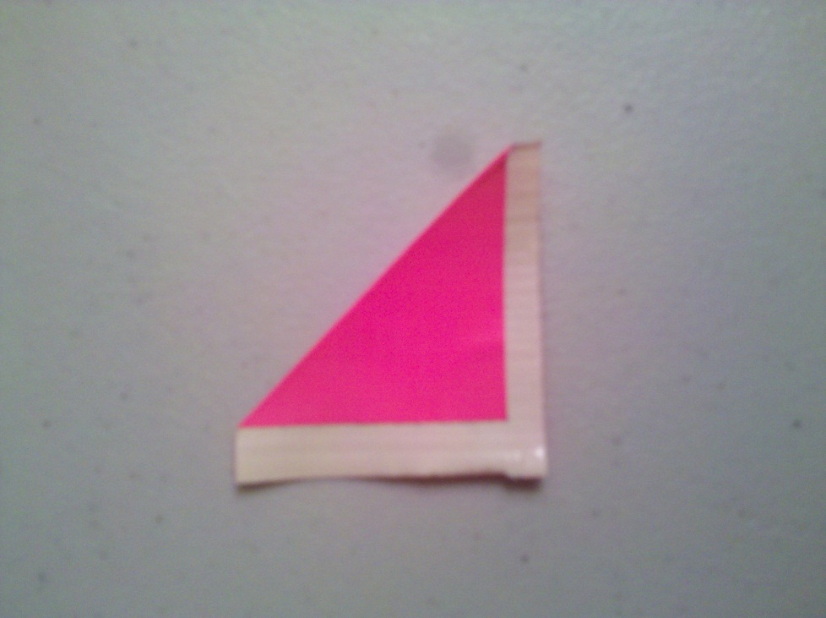
5. Fold one corner of a square of duct tape diagonally down to its opposite end. Leave a sliver of space between the fold and the edge of the square.

Slide 9
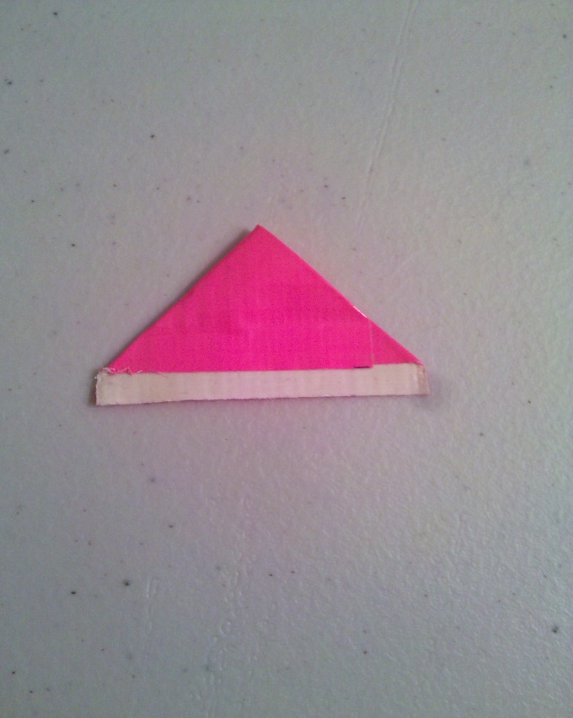
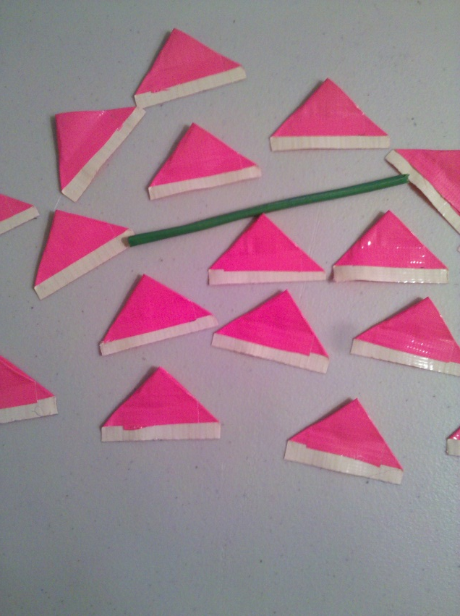
6. Fold the other corner down the same way. You should now have a triangle of colored duct tape with a rectangular sliver of adhesive attached to the bottom. Repeat this until you have twenty (20) of this shape. These shapes will form the petals.

Slide 10
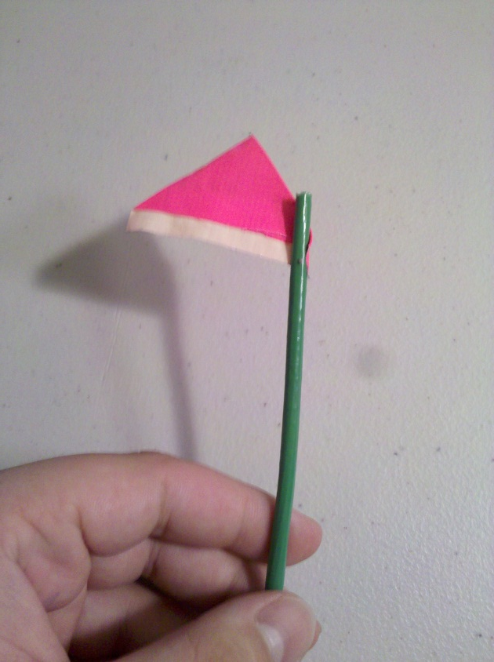
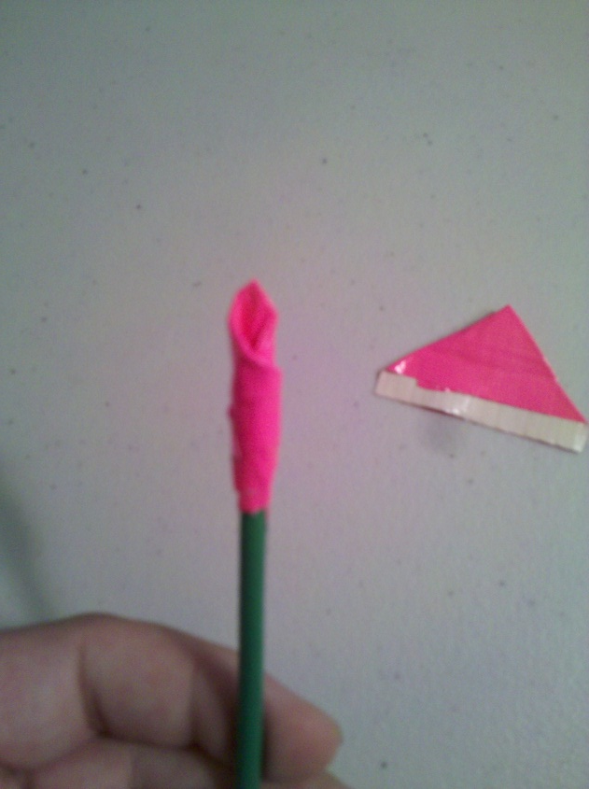
7. Begin to place the petals on the stem. Roll one petal around the end of your stem of green duct tape.

Slide 11
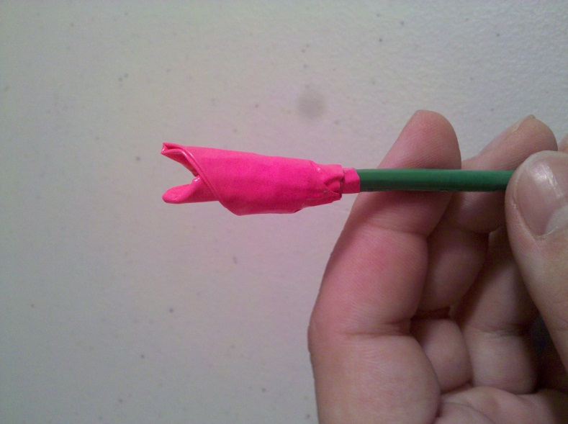
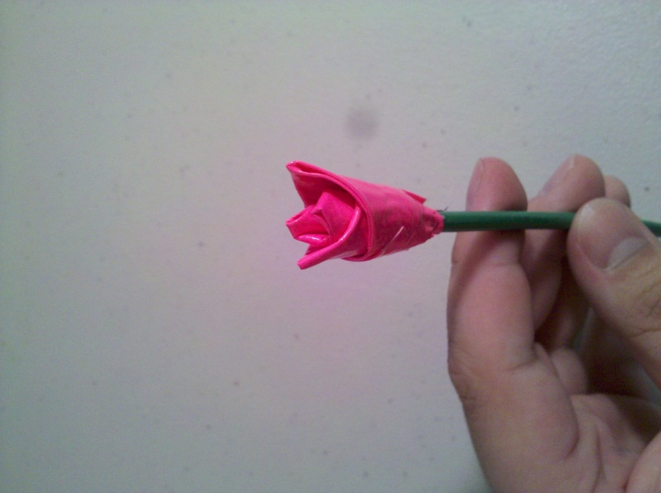
8. Continue rolling petals around the end, placing them in the same points as an imaginary compass. Place the petals on North, South, West, East, and then a second layer on Northwest, Southeast, Northeast, Southwest. Keep placing petals in this alternating pattern.

Slide 12
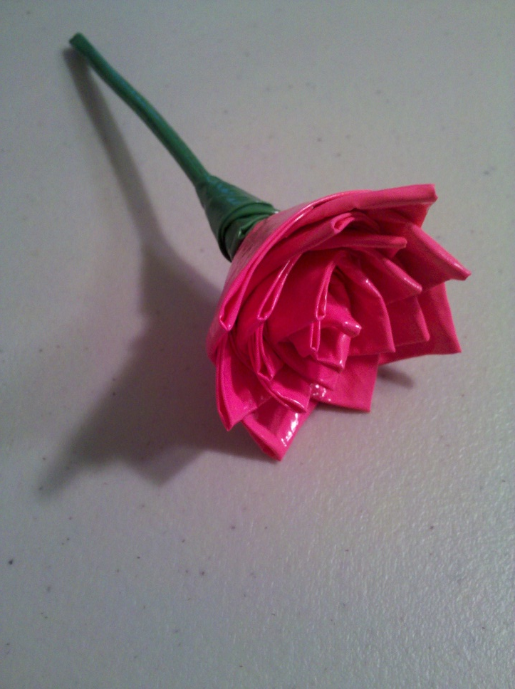
9. By the end you should have a simple rose made out of duct tape. Tip: For a good finishing touch, make two more petals out of green duct tape and wrap them just below the flower.
Green Petals

Slide 13
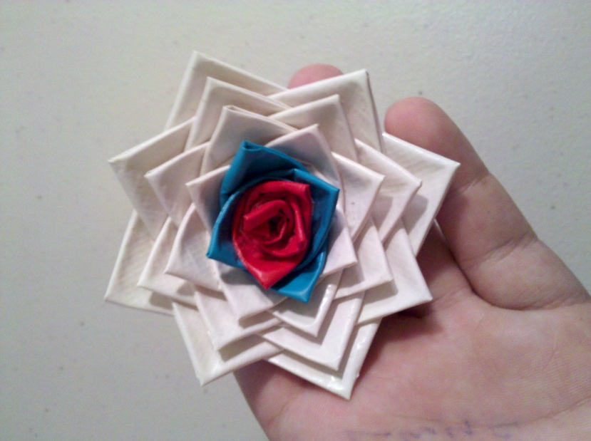
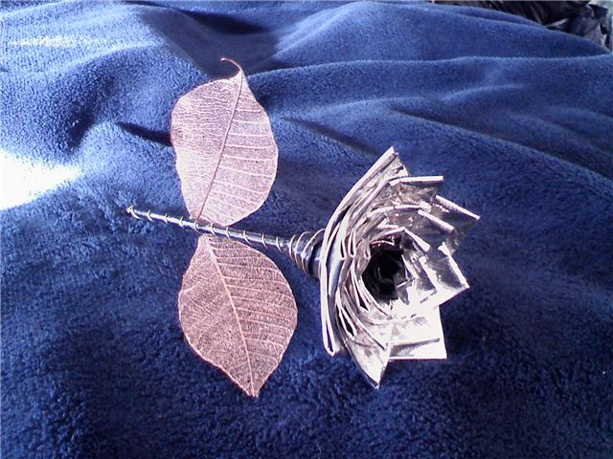
Congratulations, you now have a rose made out of duct tape! You can give these to a special someone, or just keep it around to admire it. Try new color combinations for more impressive results.

